Slide 1


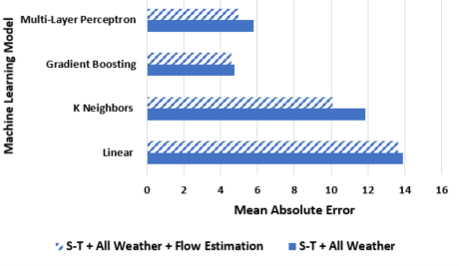
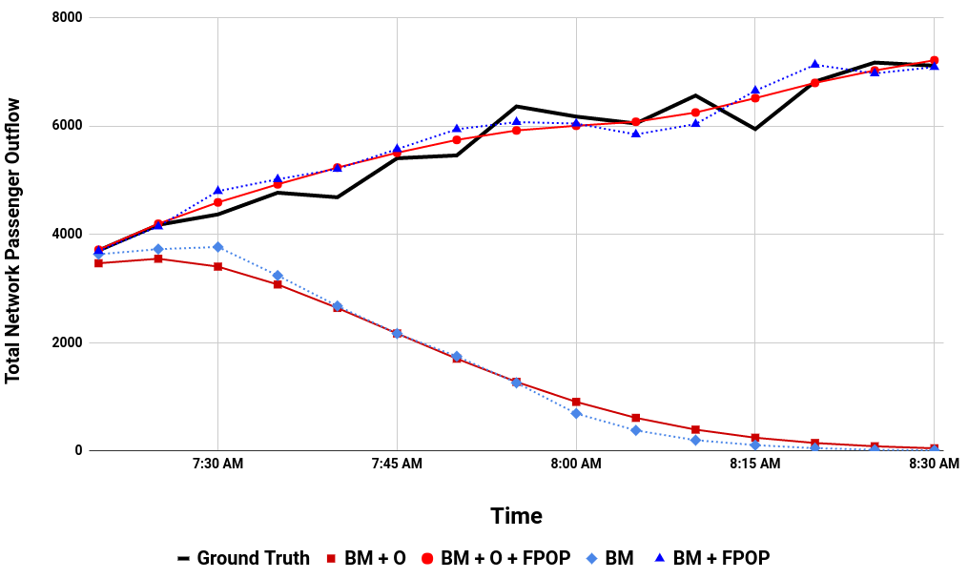
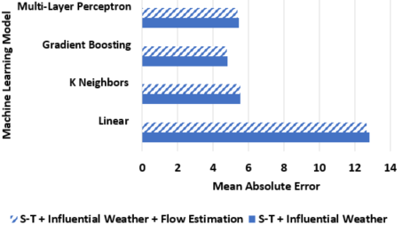
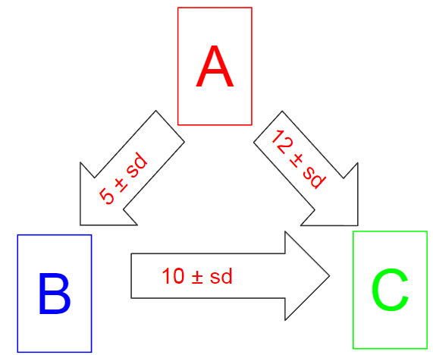
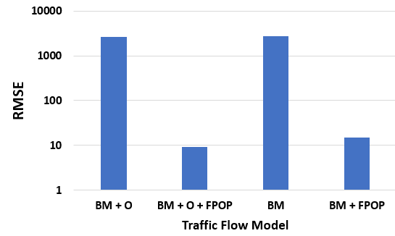
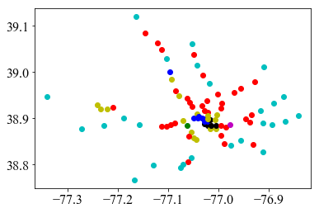
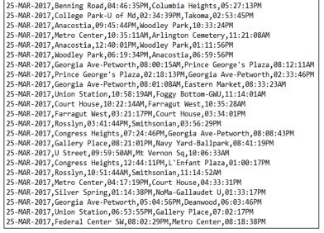
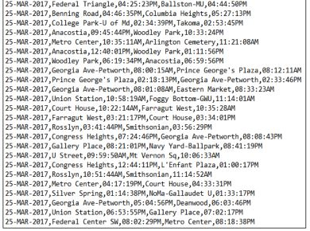
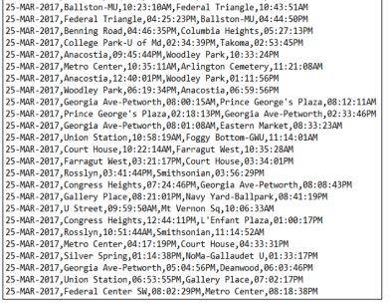
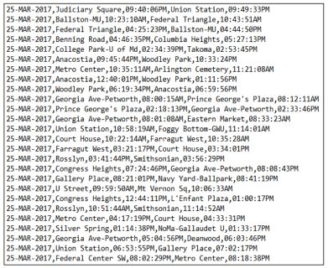
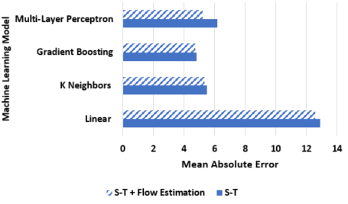
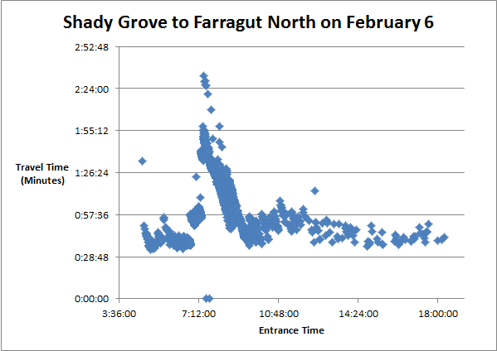
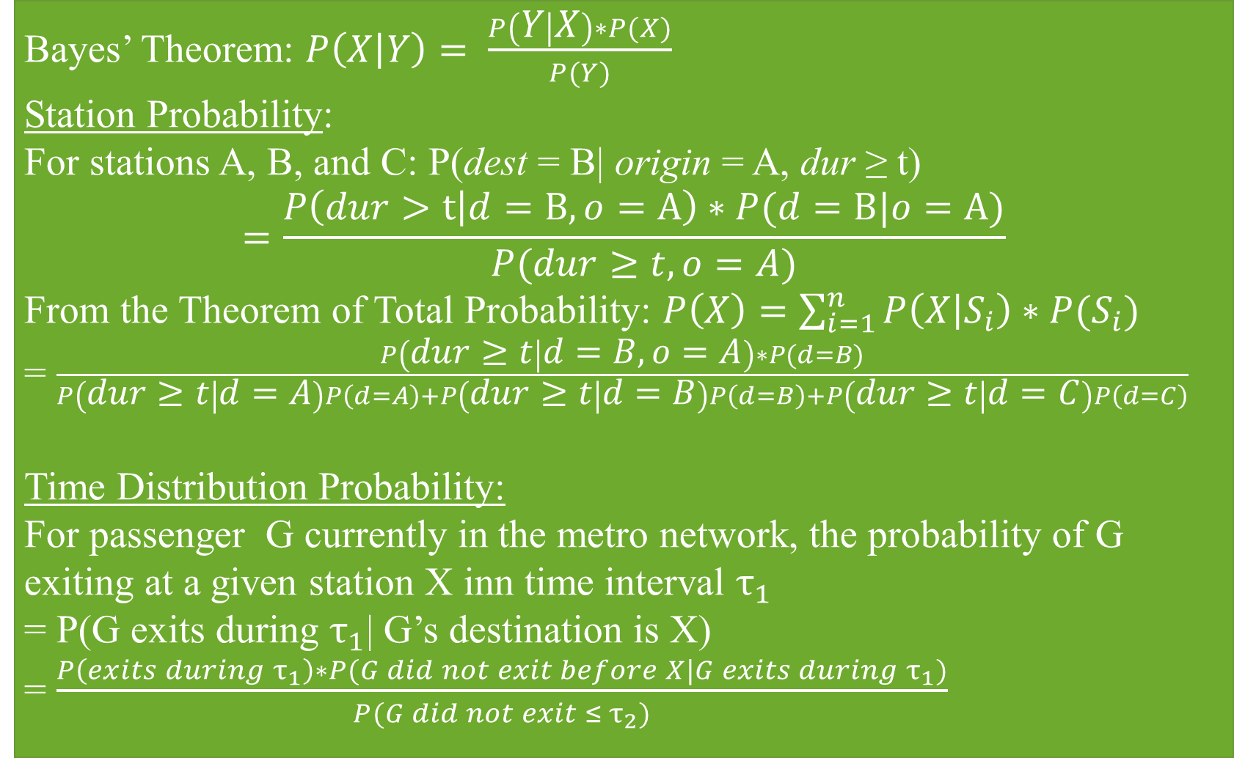
Fold or cut poster here
Fold or cut poster here
Dynamic Origin-Destination Travel Time and Traffic Flow Estimation through Heteroskedastic Poisson Processes and Machine Learning
Eric Lin
Thomas Jefferson High School for Science and Technology
https://www.wmata.com
Abstract
Theory
Methods
Test Data
Public transit systems around the world are gaining ridership as a conveniently accessible and ecologically friendly mode of transportation. However, aging infrastructure has led to increasing delays in trip travel times and variances in traffic flow. Accurate forecasts of origin-destination (OD) movement data is exceptionally beneficial for public transit system passengers and authorities. Passengers can avoid traffic congestion and authorities can anticipate and prevent network bottlenecks. We present a micro-prediction, generative heteroskedastic poisson-distributed approach to predict origin-destination (OD) traffic flow for long term predictions. This resolves the deficiencies current approaches experience in long term prediction. Furthermore, we fuse the traffic flow estimation with machine learning regression models to forecast individual passenger trip times.
Experimental evaluation shows that the proposed model for OD traffic flow provides a robust solution to the long-term deficiencies of baseline and previous Bayesian-based approaches, particularly when predicting further into the future. The model for OD individual trip duration also surpasses baseline forecasting approaches, achieving an average absolute error of 4.5 minutes. This is a vast improvement on the performance of commercial vendors which achieve an average absolute error of 7.8 minutes. These tests show that the proposed model can be successfully implemented for a wide array of OD movement data for smart city planning.
Bayes’ Theorem: $P\left(X | Y\right)= \frac{P\left(Y | X\right)∗P(X)}{P(Y)}$
Station Probability:
For stations A, B, and C: P(dest = B| origin = A, dur ≥ t)
$$=\frac{P\left(dur>t | d=B, o=A\right)∗P(d=B|o=a)}{P(dur≥t, o=A)}$$
From the Theorem of Total Probability: $P\left(X\right)=\sum_{i=1}^{n}{P\left(X | S_{i}\right)∗P(S_{i})}$
= $\frac{P\left(dur≥t | d=B,o=A\right)∗P(d=B)}{P\left(dur≥t | d=A\right)P\left(d=A\right)+P\left(dur≥t | d=B\right)P\left(d=B\right)+P\left(dur≥t | d=C\right)P\left(d=C\right)}$
Time Distribution Probability:
For passenger G currently in the metro network, the probability of G
exiting at a given station X inn time interval $τ_{1}$
= P(G exits during $τ_{1}$| G’s destination is X)
= $\frac{P\left(exits during{ τ}_{1}\right)∗P(G did not exit before X|G exits during{ τ}_{1})}{P(G did not exit ≤{ τ}_{2})}$
Machine Learning was used for predicting travel time
Feature sets
Spatio-temporal time series (S-T) + Flow Estimation
S-T + All Weather + Flow Estimation
S-T + Influential Weather + Flow Estimation
Trip: Origin and Destination time and station
16,407,326 trips from 91 stations between Mar. 24, 207 to Apr. 24, 2017
Results
BM: Bayesian Model (short-term prediction)
BM + O: Bayesian Model with removal of outliers
BM + FPOP: Bayesian Model with Future Passenger Outflow Prediction
BM + O + FPOP: Bayesian Model with Future Passenger Outflow Prediction and removal of outliers
Station Bayes
Time Distribution
Figure 8. Mean absolute error for S-T + All Weather trip travel time estimation.
Outflow Estimation
Methods
Short-term Prediction
We approach the macro-problem of traffic flow from a micro standpoint by looking at each passenger
At a given time, take all passengers in the Metro network
Predict for each passenger the probability of him at a specific time arriving at a destination station
Partition each passenger into the probability distributions and allocate it to each station time bucket
Summation of the micro probabilities in a time interval for a station gives the estimated outflow
Repeating this process for thousands of users provides an accurate prediction
Figure 5. Comparison of outflow estimations for entire subway network.
Introduction
Figure 4. Example of Bayes
Figure 9. Mean absolute error for S-T + Influential Weather trip travel time estimation.
Public transit trips are up 34% since 1995, which is higher than the population growth of 21% [2].
Past research employed machine learning algorithms to model station in and out flow based on large-scale patterns [1].
Conclusions
First solutions to long-term subway traffic flow estimation
Bayesian model captures empirical distributions while allowing conditioning to individual travel times
Generative heteroskedastic Poisson models and machine learning
Travel time estimation: average absolute error of 4.5 minutes outperform commercial vendors’ average absolute error of 7.8 minutes by 42%
Future work:
Optimize machine learning regression models
FPOP through Markov chains
Future Passenger Prediction (FPOP)
Previously discussed Bayesian model retains high accuracy only for the short term and thus depends on live data input
Trick is to be able to predict traffic inflow and not rely on live data
Heteroskedastic Poisson process: variation of traffic inflow fluctuates with other variables, such as time
From derivations, historical inflow average is accurate
Figure 6. Passenger flow prediction root-mean-square errors.
Figure 2. Raw trip data.
Acknowledgements
Figure 1. Clustering of stations based on time-series.
Weather
This material is based upon work supported by the National Science Foundation under Grant CCF-1637541 titled "AitF: Collaborative Research: Modeling movement on transportation networks using uncertain data”. Many thanks to Dr. Andreas Züfle, of Geography and Geoinformation Science, George Mason University. References R. Truong, O. Gkountouna, D. Pfoser, and A. Züfle. Modeling and prediction of passenger volume in public transport. 2017. Public Transportation. (n.d.). Retrieved August 04, 2017, from http://www.apta.com/mediacenter/ptbenefits/Pages/default.aspx
Subway trains are operated by humans, resulting in variances in speed, especially during cases of weather
Average temperature
Average humidity
Visibility distance
Wind speed
Precipitation
Meteorological events e.g. thunderstorms
Figure 7. Mean absolute error for S-T trip travel time estimation.
Figure 3. Time-series of a OD pair.
Fold or cut poster here
Fold or cut poster here

